Slide 1
CrazyFlie Swarm Research Project
Spring 2017 Senior Design Project Team32 -May1732
Advisors: Dr. Nicola Elia, Dr.Phillip Jones Technical Advisor: Ian McInerney

Slide 2
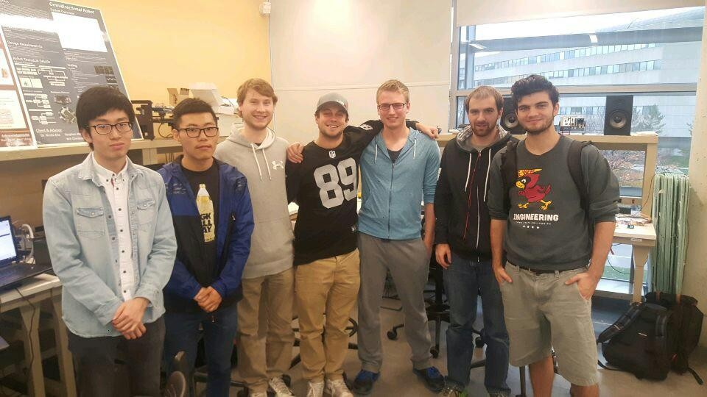
Meet The Team
Nick Robbins - Project Lead
Cole Beaulieu - Communications Lead Jacob Frazier-Flores - Web Design Lead Grant Manley – Co-Webmaster
Ben Nelson – Concept Leader Tianxiang Shen- Co-Idea Leader Chengrui Yang- Co-Idea Leader

Slide 3
Problem Statement
As it stands currently, the Crazyflie open source platform enables the user to fly one or two small crazyflies with an included radio. We wish to expand this design to include the following items:
Improve communication system to support multiple crazyflies
Peer-to-peer Crazyflie communication
Build a big-quad to handle larger payloads

Slide 4
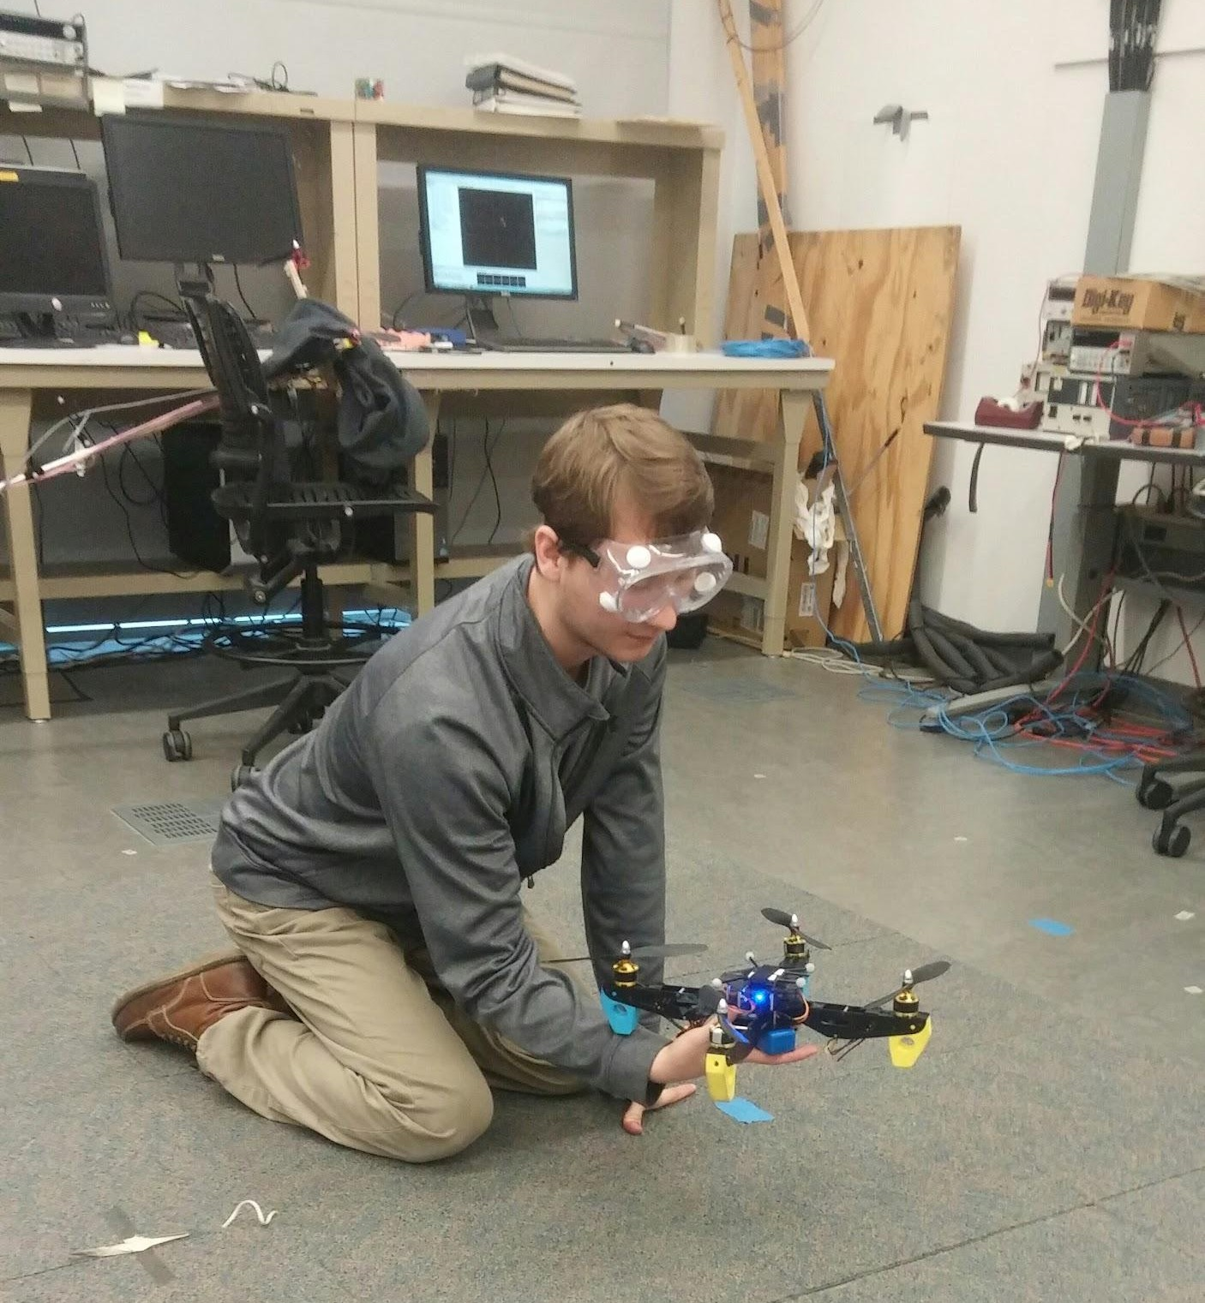
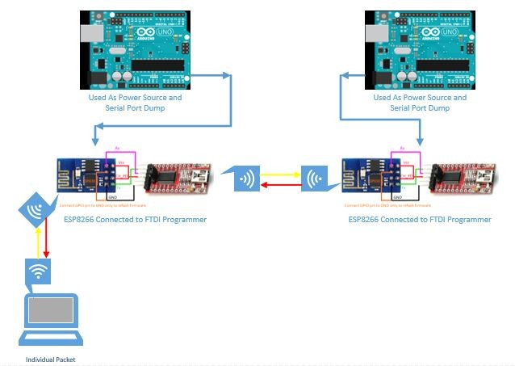
Project Goals
Extending the CrazyFlie electronics to larger quadcopters
Implement Wifi Communication
Develop Communications Network Between CrazyFlies

Slide 5
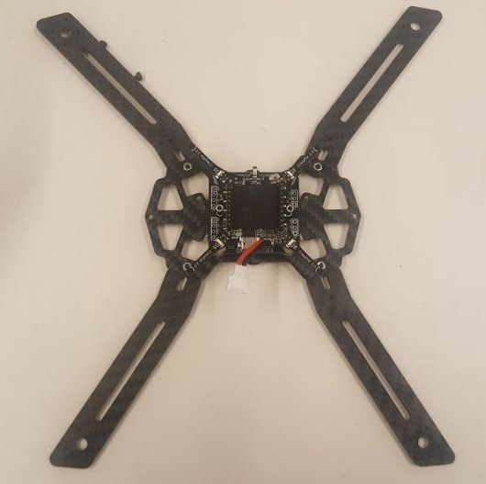
System Specifications
Design an intermediate quad
Redesign the communication systems using a Wifi-module
Edit firmware so quad to quad communication can occur
Use the camera systems provided to help log data with the tracking systems for giving 3D spacing requirements

Slide 6
Functional Requirements
Non-Functional Requirements
Datalink between Crazyflie and ground station is reliable
Code produced is documented, maintainable, and extensible
Crazyflies fail gracefully (no crashes)
Setpoints need to be sent frequently (< every 5ms)
High data transfer rate for quad to quad and ground station to
quad
Fly 5-10 quads at once
Coordinate multiple quads to perform a simple task
  Ex. Lift a heavy load together
Quad-to-quad communication
Enable BigQuad Expansion Deck
  Mount deck on large quad
  Enable in Firmware
  Find new PID values

Slide 7
Technical Considerations
The wifi module only supports 8 connections at one time
A light, accurate altimeter for quad.
Latency
Weight/Payload

Slide 8
Resource/Cost Estimate
BigQuad major parts including frame, motors and ESC - $126.13/ unit
Two expansion boards - $7/unit
Crazyflie Quadcopter - $200/unit
● ESP8266 - $7/unit
Camera System - TBD about $80

Slide 9
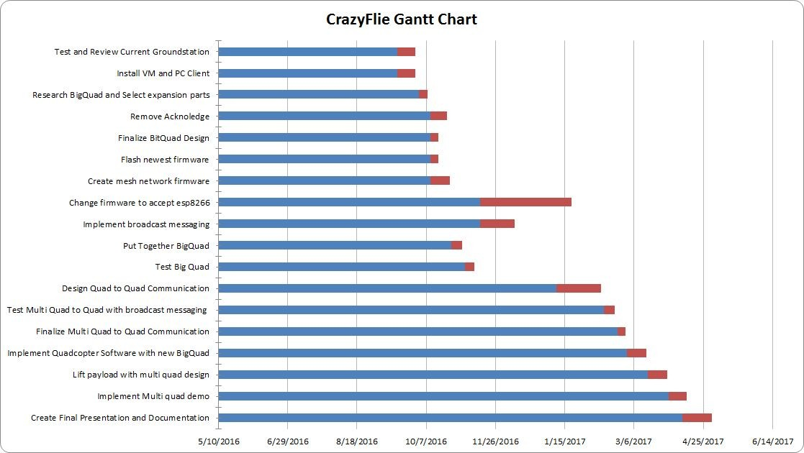
Project Milestones & Schedule
Completed
Completed Completed
Modified Completed Completed
Completed
In Progress Completed
Completed
In Progress

Slide 10
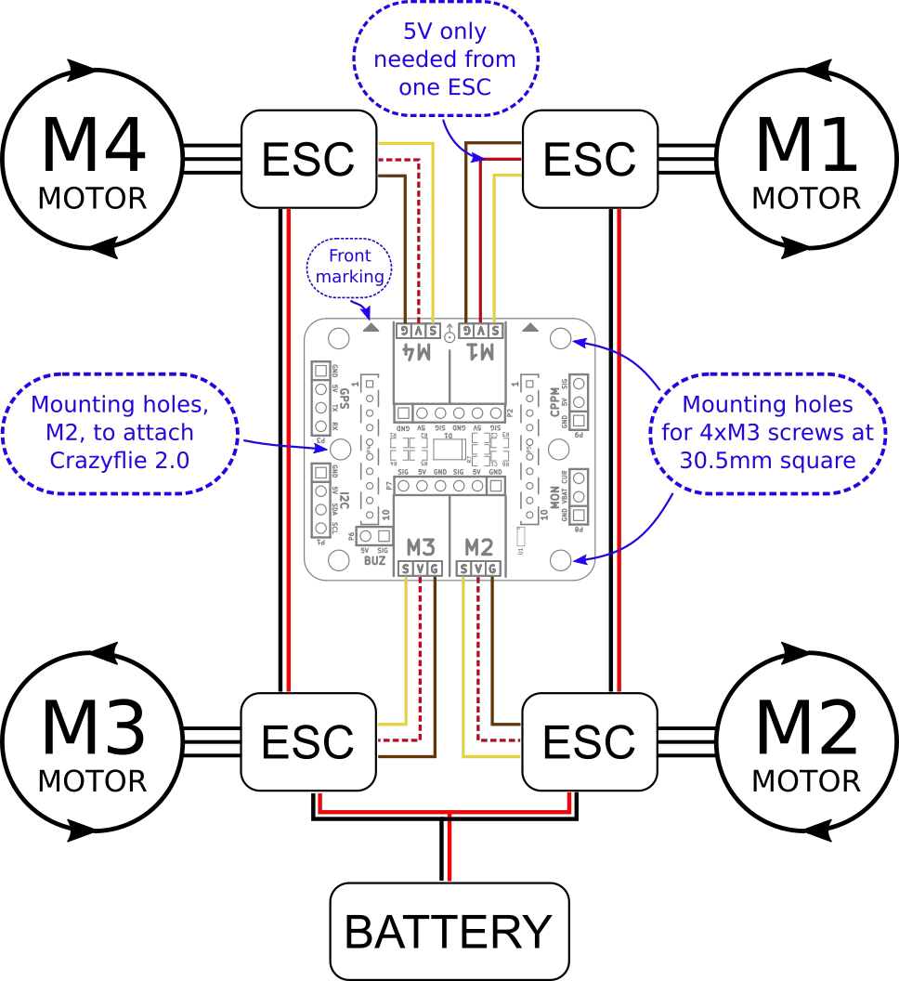
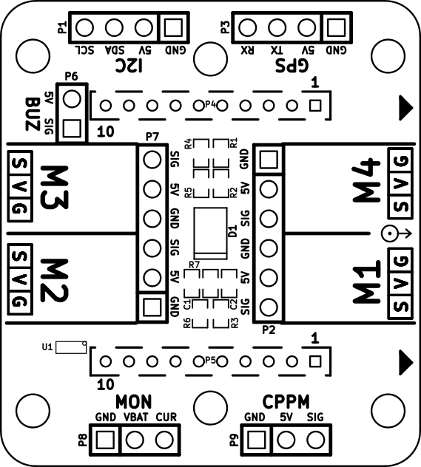
Hardware Designs
BigQuad
Expansion deck
ESC connection

Slide 12
Hardware Design cont.
FPV
Camera System
Camera
Transmitter
Receiver
PC
monitor

Slide 13
Hardware Design cont.
PC
monitor
Camera
Transmitter
Receiver
Improved Camera System
Ultrasonic Detector
Altitude Detector
Firmware
CrazyFlie
PC
monitor
Camera
Transmitter
Receiver
Advanced Camera System
Choose a feature
CrazyFlie
Firmware
OpenCV

Slide 14
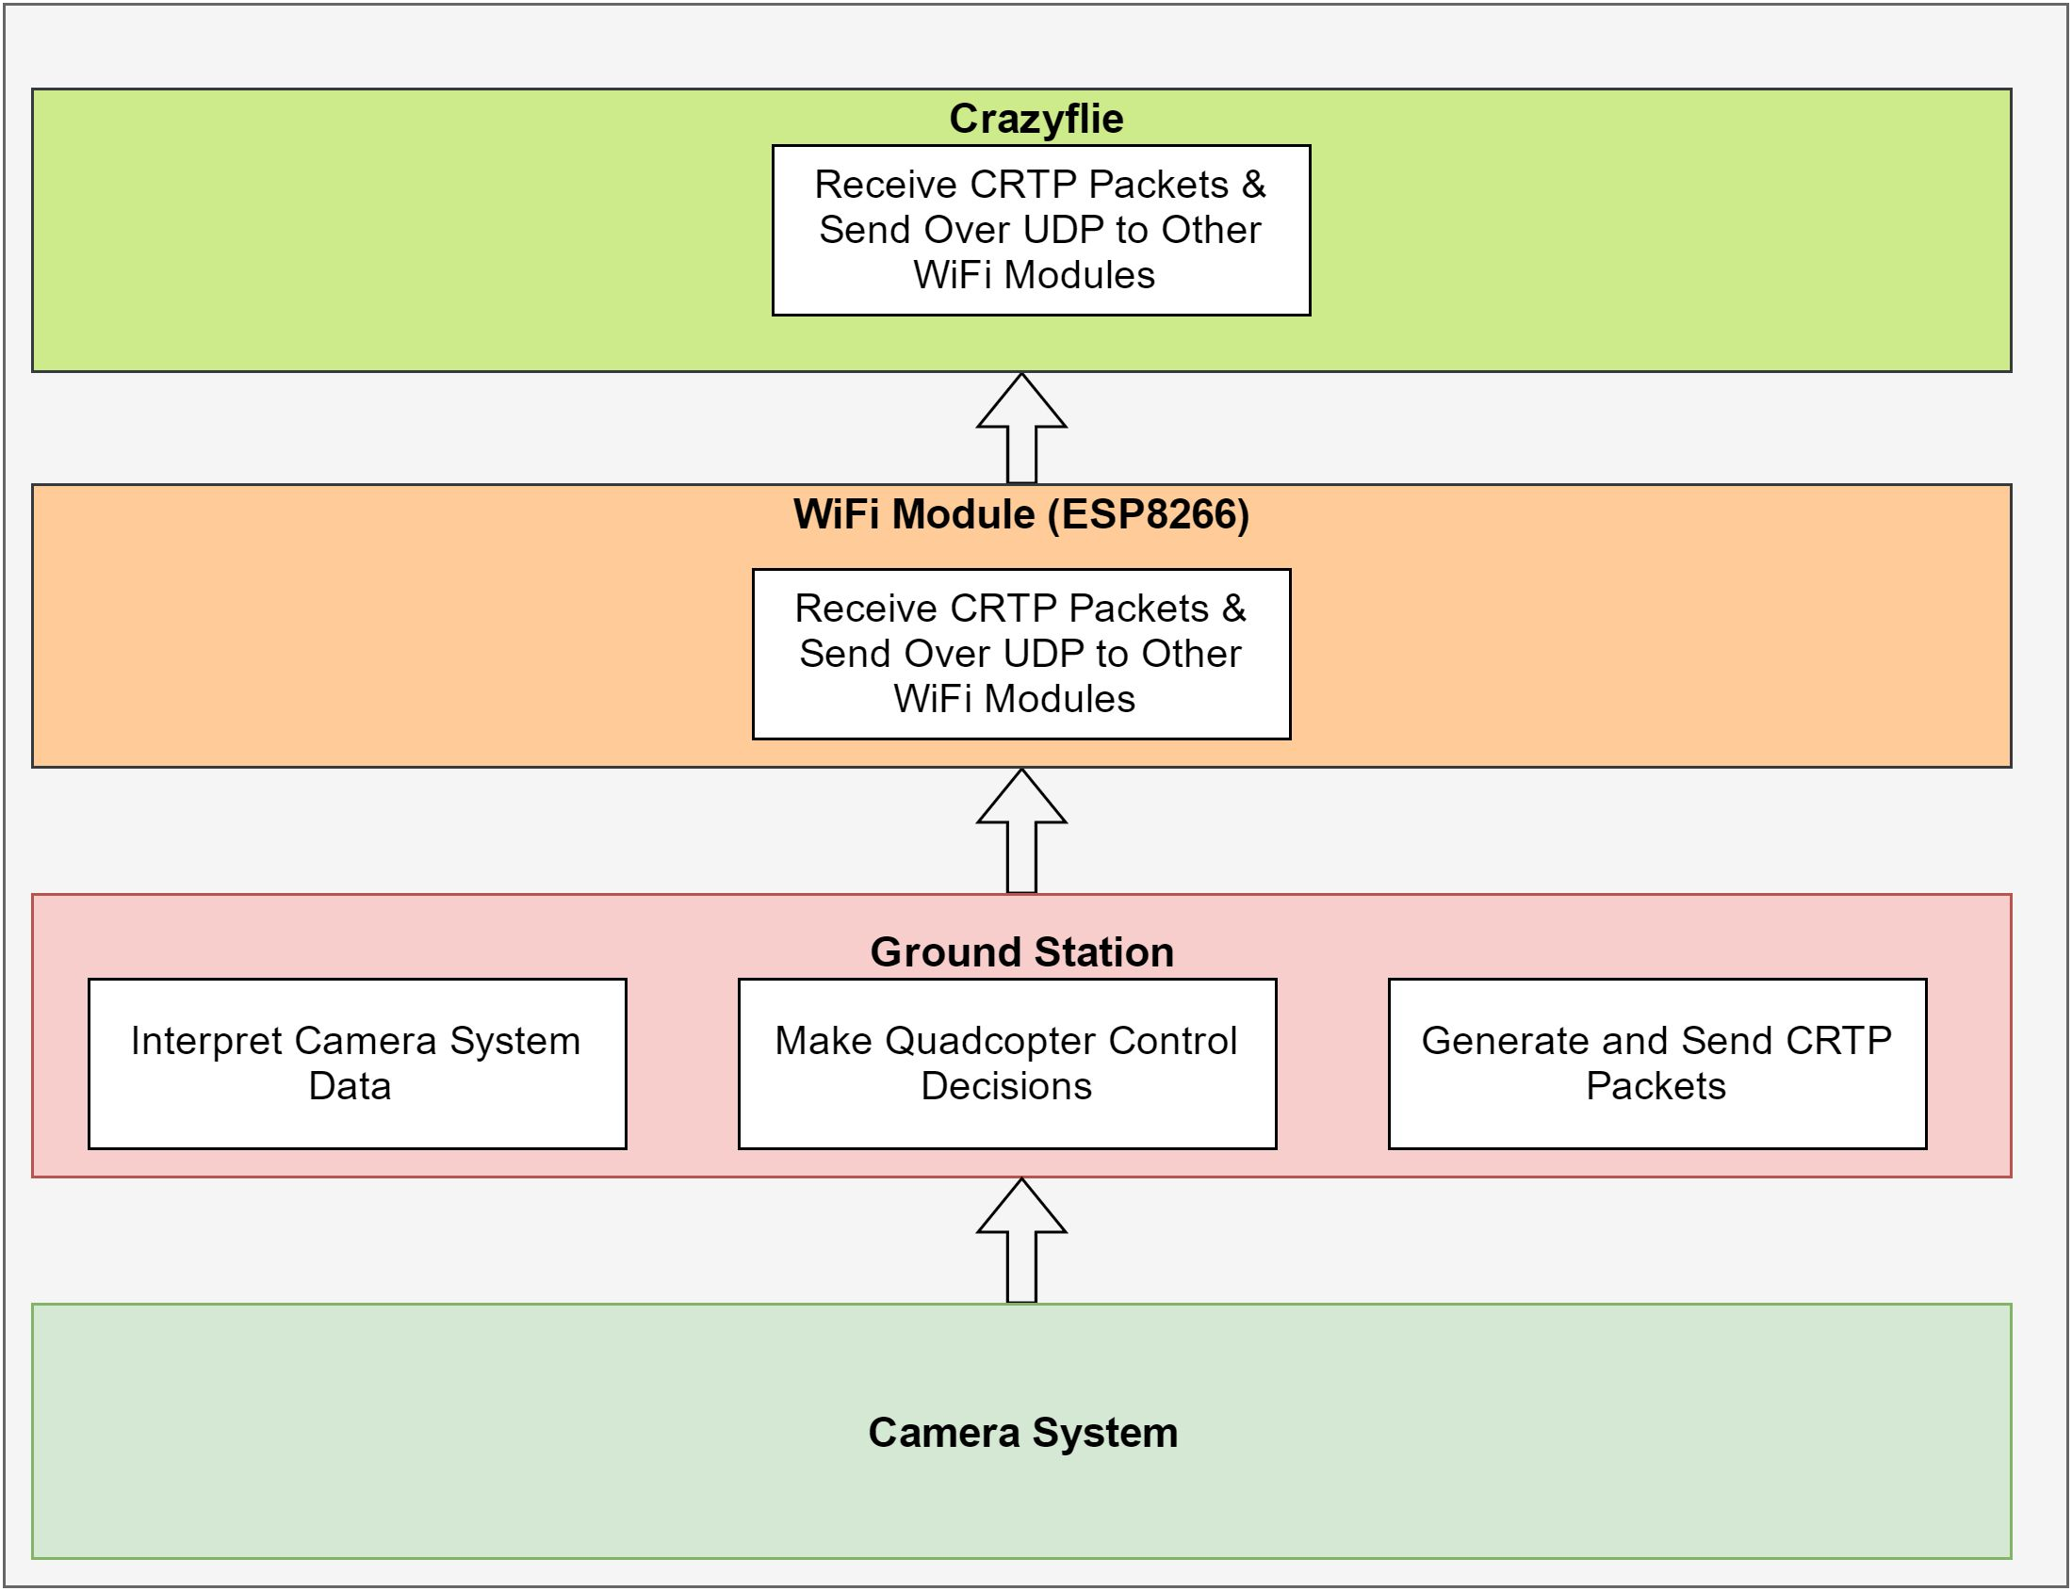
Software Design
The Camera System uses trackables to find Quad Position
Ground station interprets position, makes control decisions, and sends CRTP packets
WiFi module packages CRTP packets as UDP packets
Crazyflie interprets packets

Slide 15
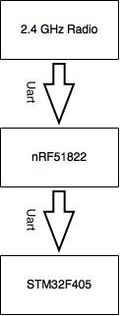
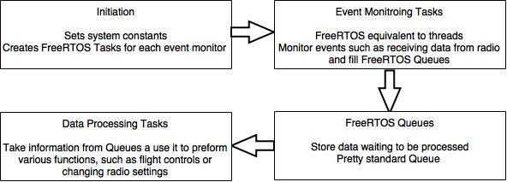
Firmware Design
Communication Flow
STM32 Firmware

Slide 16
Software used
New firmware for the ESP WiFi chips that is capable of point to point, broadcast, and mesh communication (receiving and transmitting).
Firmware adaptation for the crazyflies that allow them to receive communication from the ESP Wi-Fi chip.
New ground station code that enables communication over the new Wi-Fi device.
Arduino Libraries for ESP8266

Slide 17
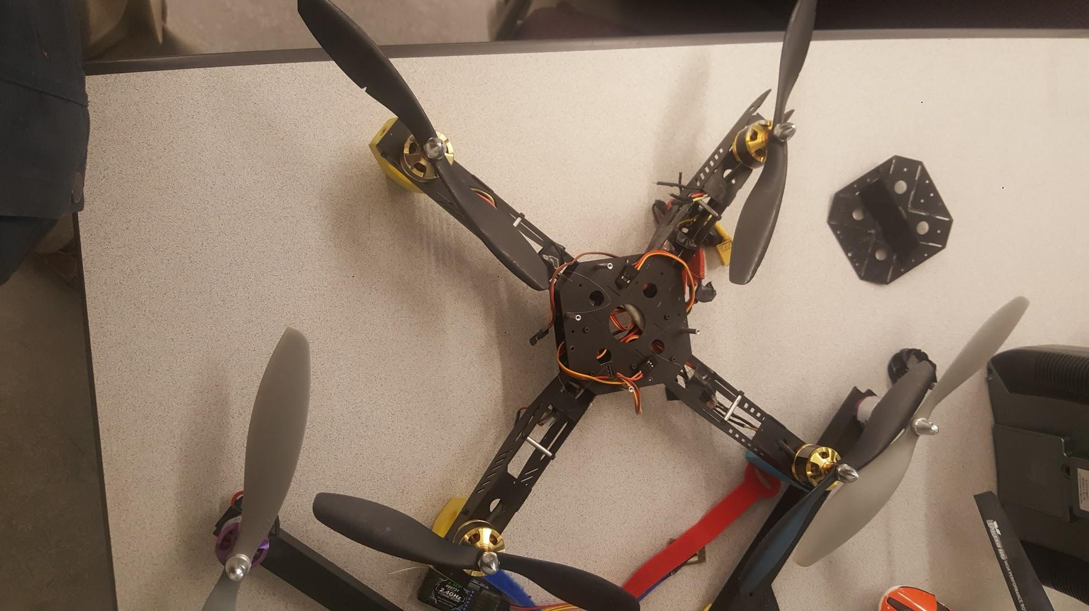
Software Challenges
Hardware Challenges
Flying old quad with crazyflie
Creating mesh network
Replacing onboard radio with WiFi module
Damaged ESC
Lack of secure mounting
Regulating 5V to 3.3V
Securely connecting ESP8266 to Crazyflie
Integrating with STM firmware
Making changes to ground station code
Understanding the Crazyflie system architecture
  Uses multiple 3rd party libraries
  Often poor documentation

Slide 18



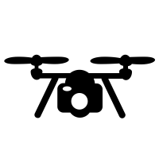
Plan for Next Semester
Multi-Quadcopter flying (WIFI)
Fly more than 5 quads at same time
BigQuad load lifting
Make sure the BigQuad works well Lift stuff
Camera system
Implement the basic FPV camera
Add Ultrasonic distance measurement tool

Slide 19
Questions

